Slide 1
Colorado Population Growth
Rob Kemp
State Demography Office
Colorado Department of Local Affairs
November 2015

Slide 2
Colorado’s Population Landscape

Slide 3
Big Picture - 2013-2014 Pop Change
US – 318 million, + 2.3 million or 0.7%
Colorado- 5,353,471
4th fastest growth at 1.6%
8th largest absolute change adding 83,700
Larimer 2014: 323,863 (+2.38%)
Growth Varies Across the State
Notes:
Ranked 4th fastest 1.6% - ND, NV, TX
8th absolute growth 83,700 – TX, CA, FL, GA, AZ, NC, WA

Slide 4
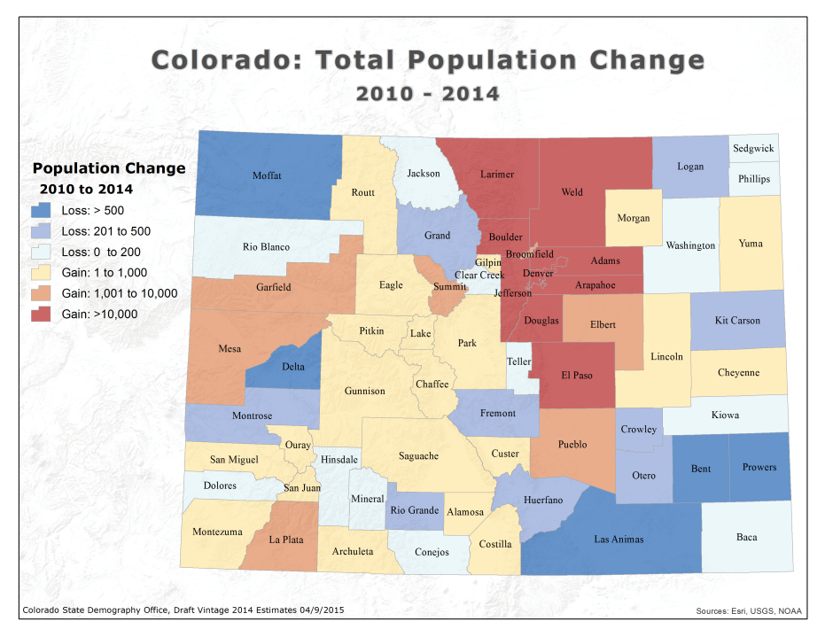

Slide 5
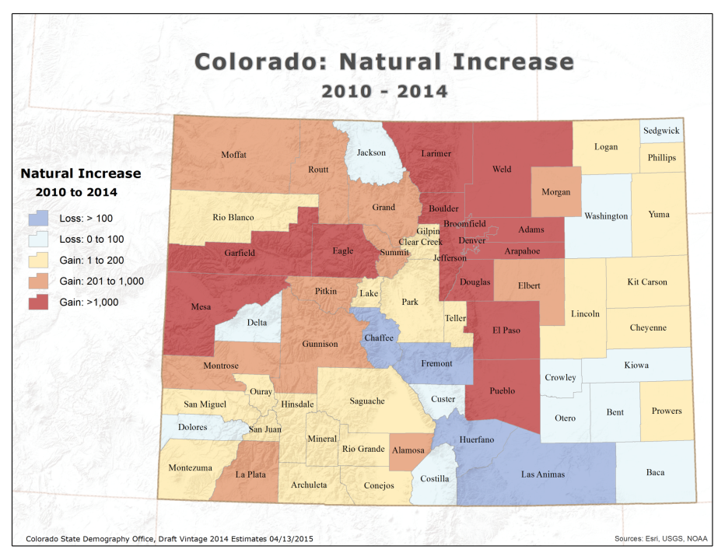
Notes:
15 counties negative natural increase

Slide 6
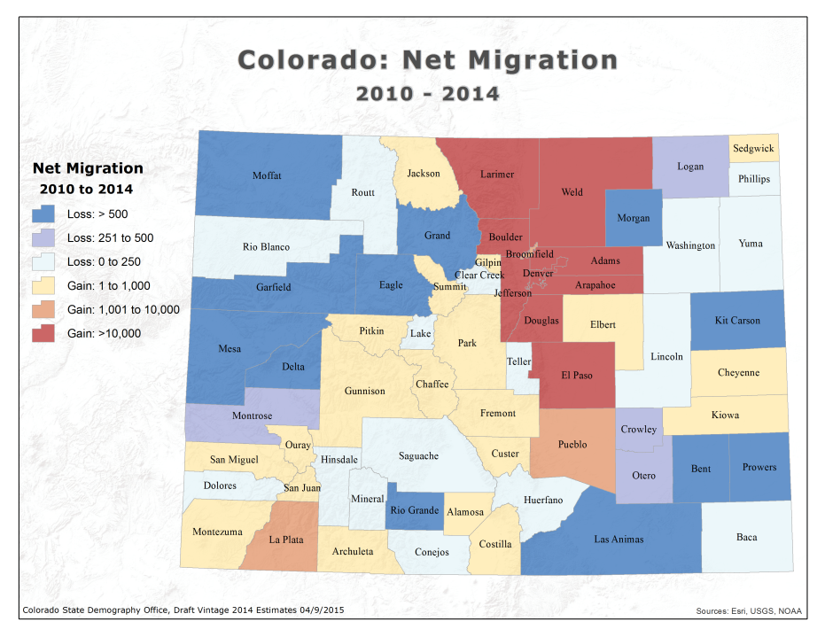
Notes:
34 counties with out migration
Bent, Crowley and Fremont had declines in prison population

Slide 7
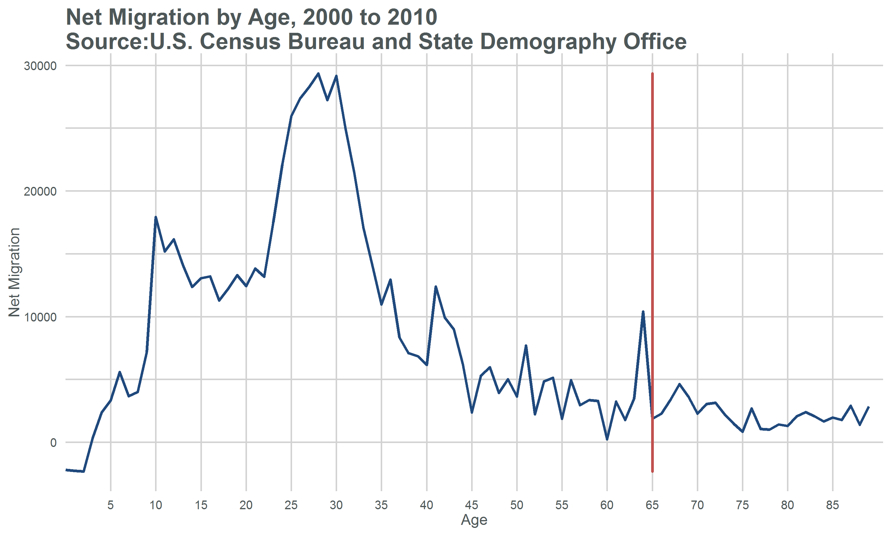
Notes:
Who are the movers?

Slide 9
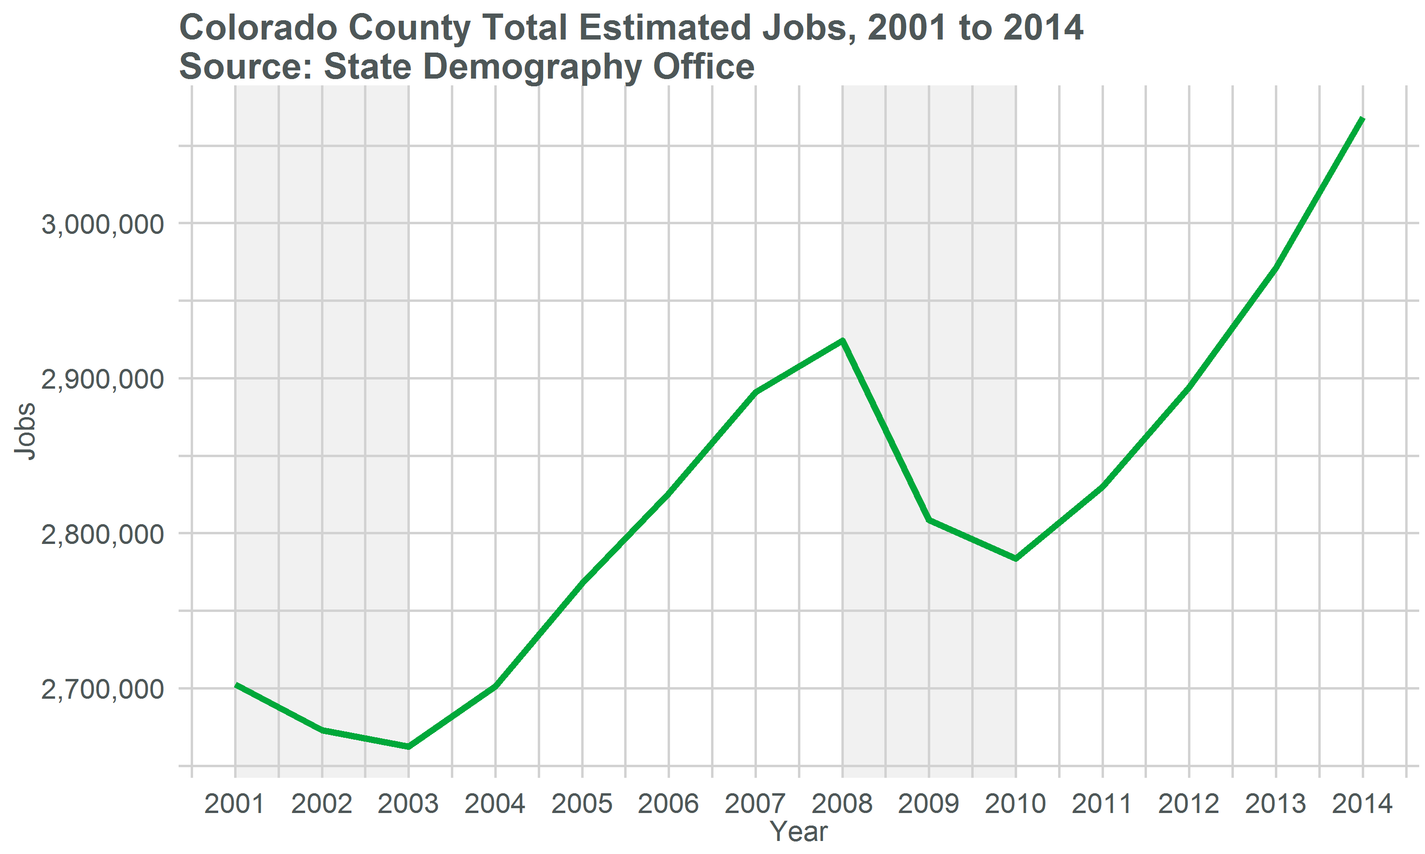
Make Font Bigger
State Demography Office

Slide 10
Population Growth

Slide 11
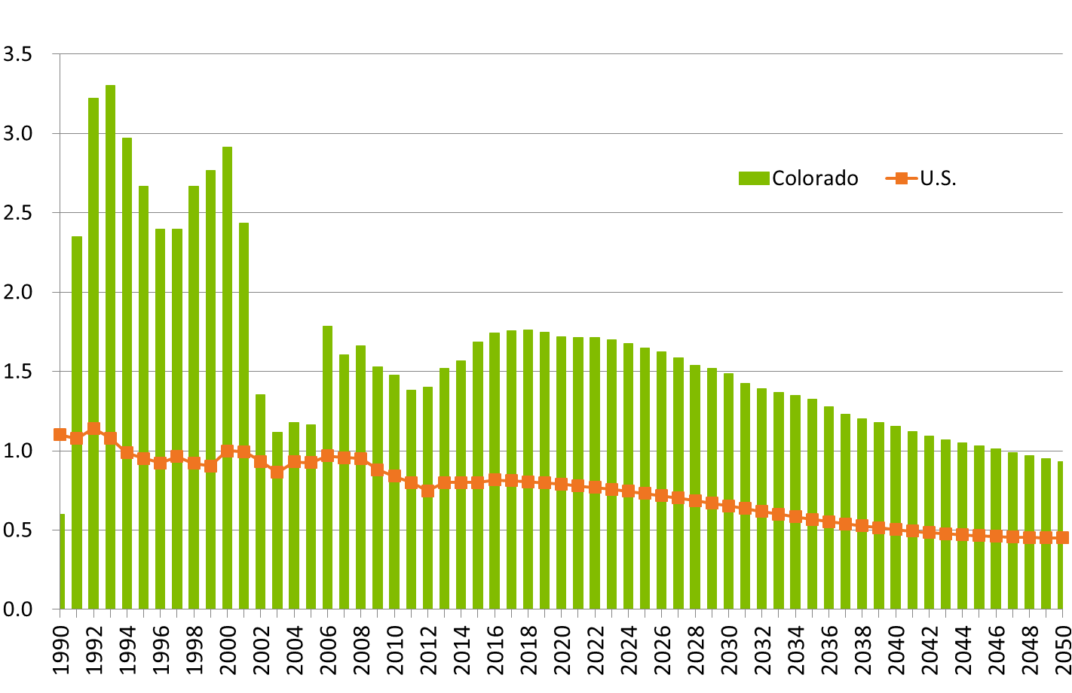
Colorado and U.S. Growth Rates

Slide 12
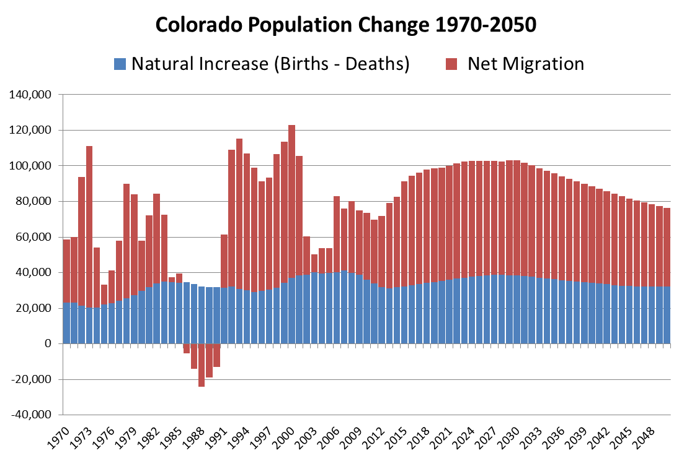

Slide 13
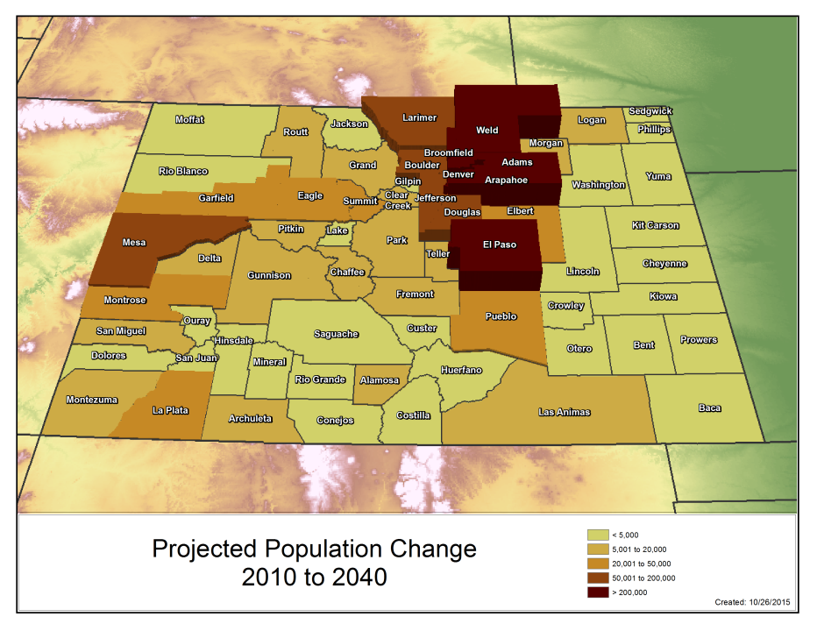
Notes:
FR 82% of states population….remain 82% throughout forecast.
2040- 7.924
Change from 2010-2040
State – 2.8 mill
Front Range – 2.4 mil
Denver Metro – 1.4
NFR - 534K
SFR - 390K
WS - 342K
CM - 61K
SLV - 11K
EP - 64K
Non Front Range - 470

Slide 14
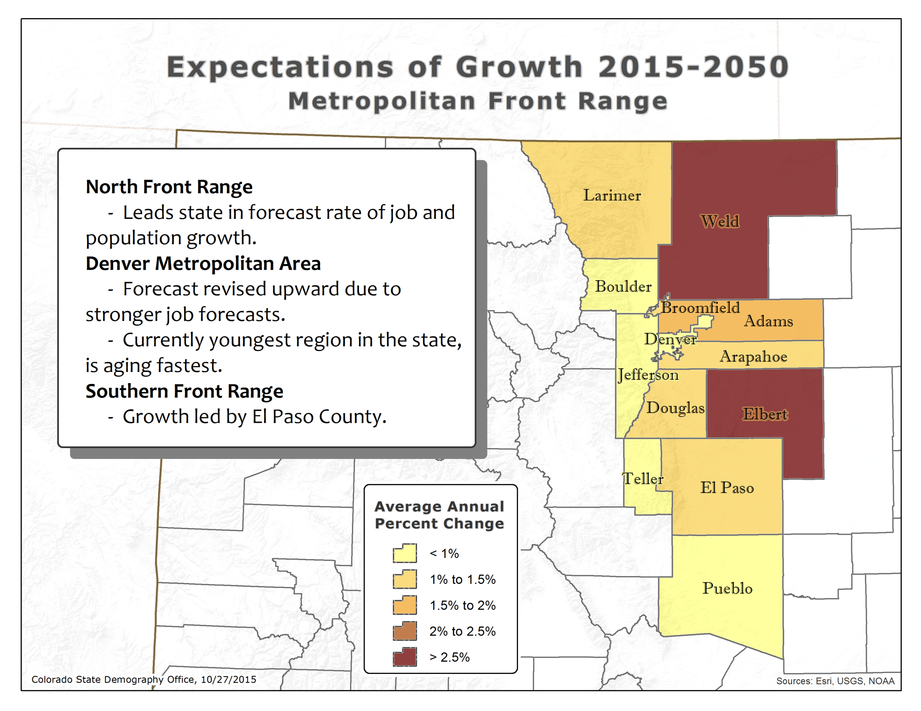

Slide 15
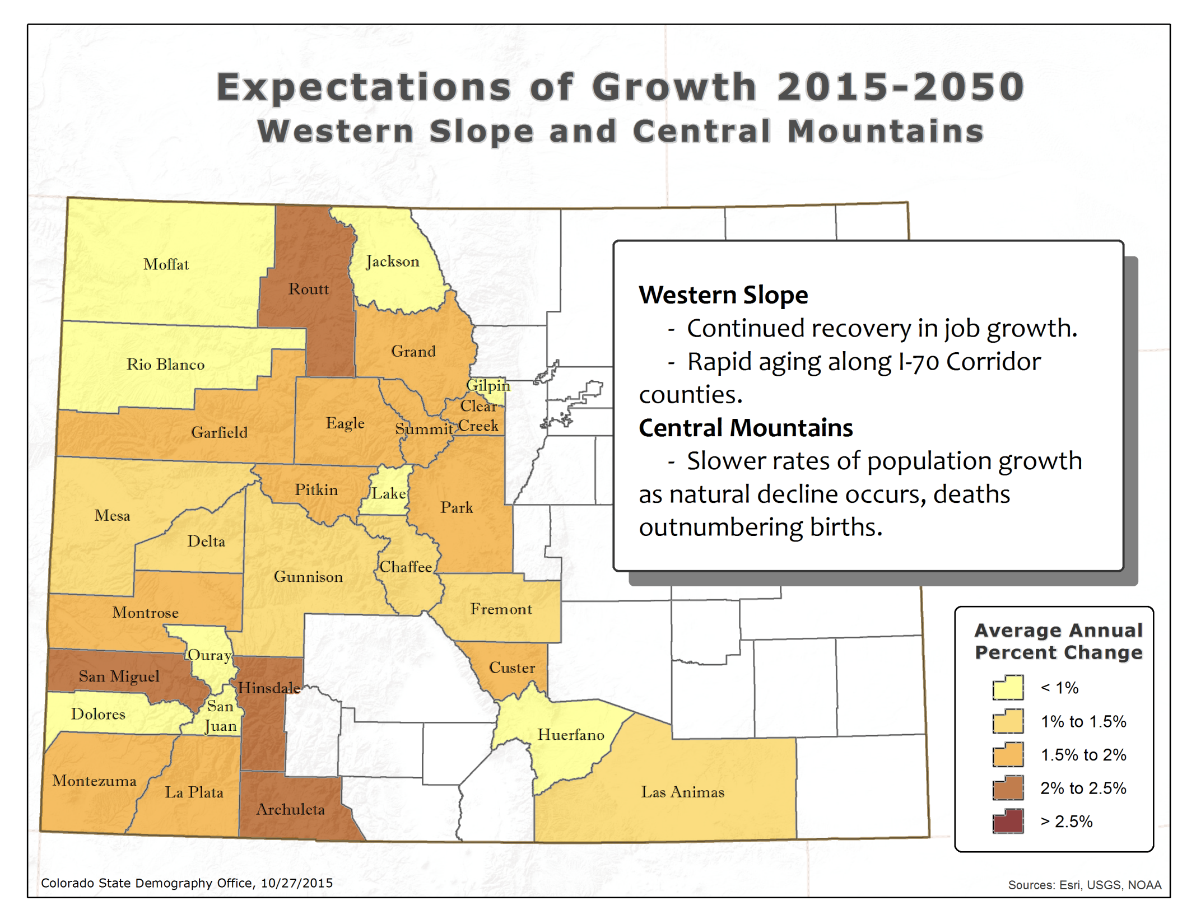

Slide 16
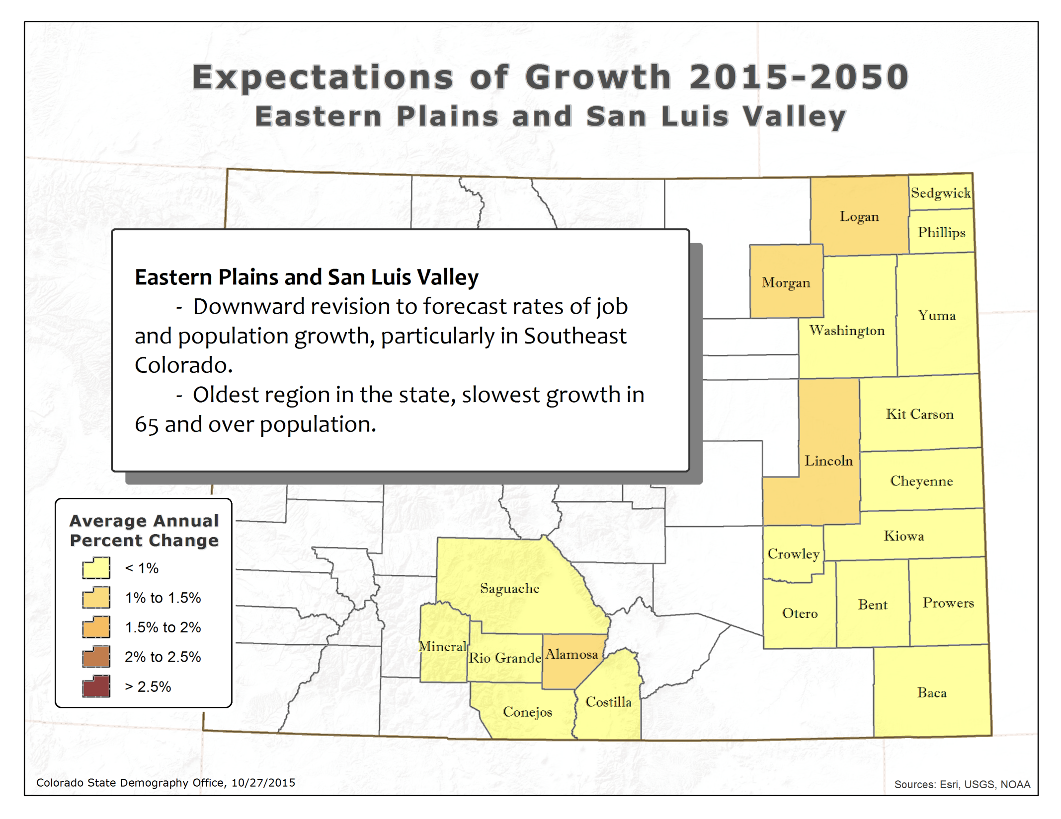

Slide 17
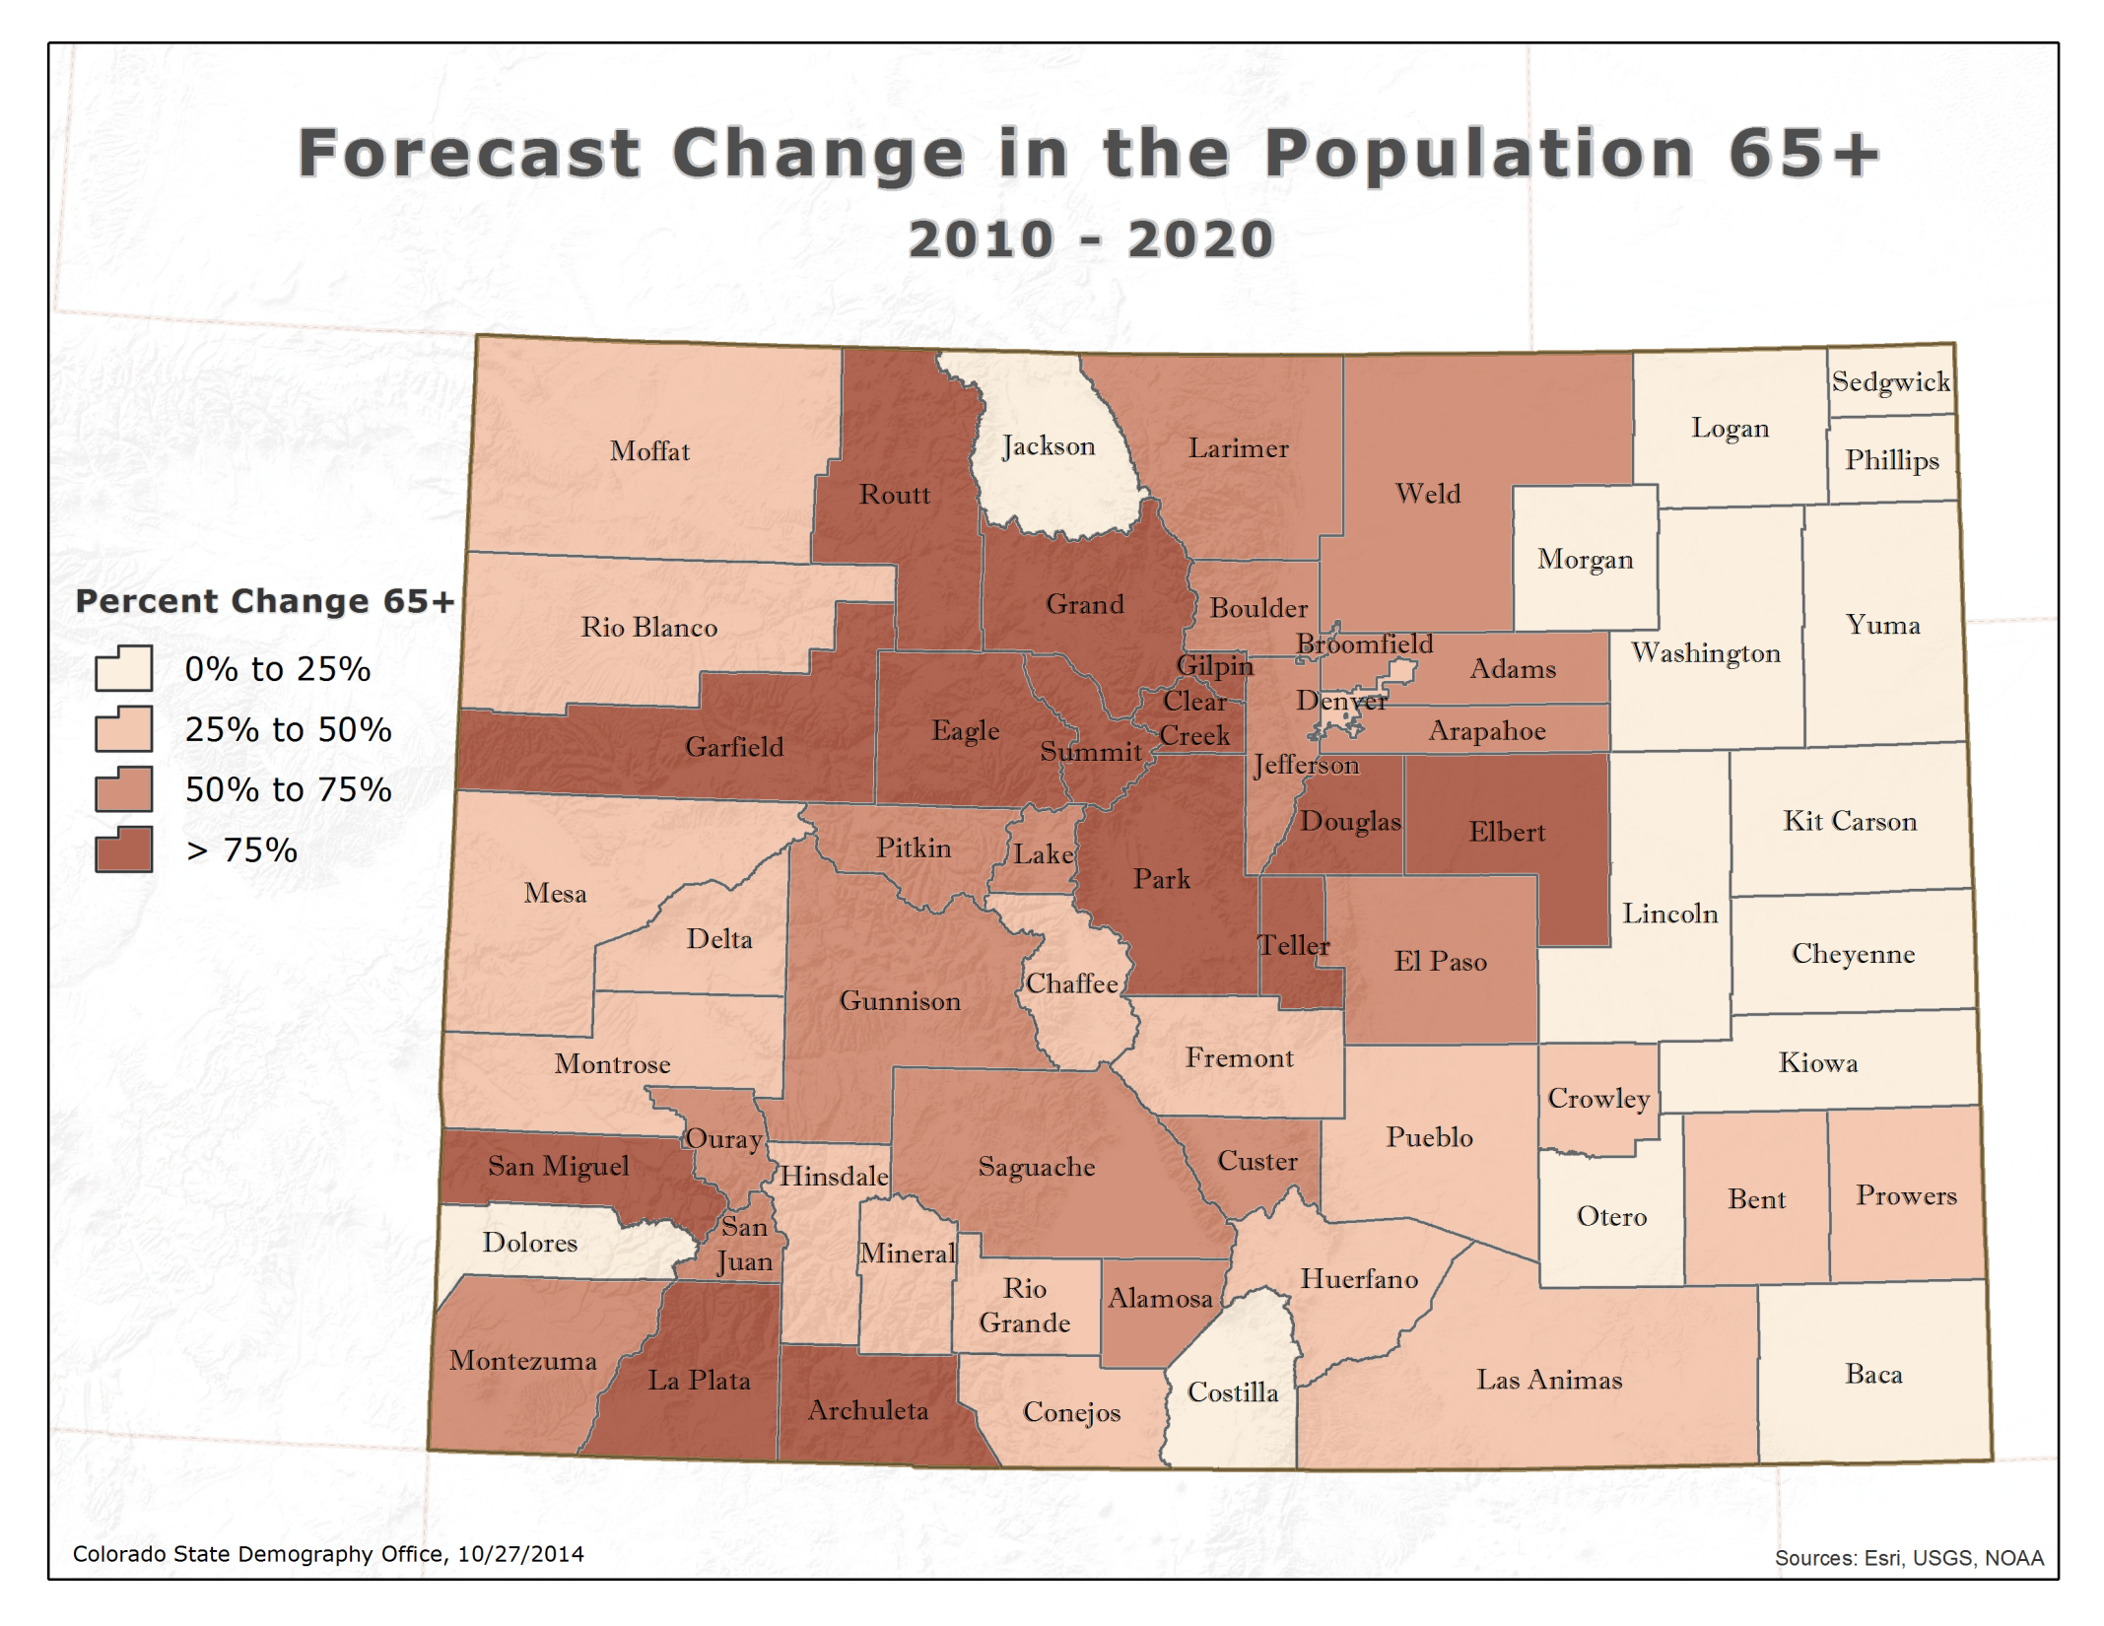
Map 65+ change
Notes:
Growing at >100%
Eagle
Elbert
San Miguel
Gilpin
Park
Grand
Summit
Douglas

Slide 18
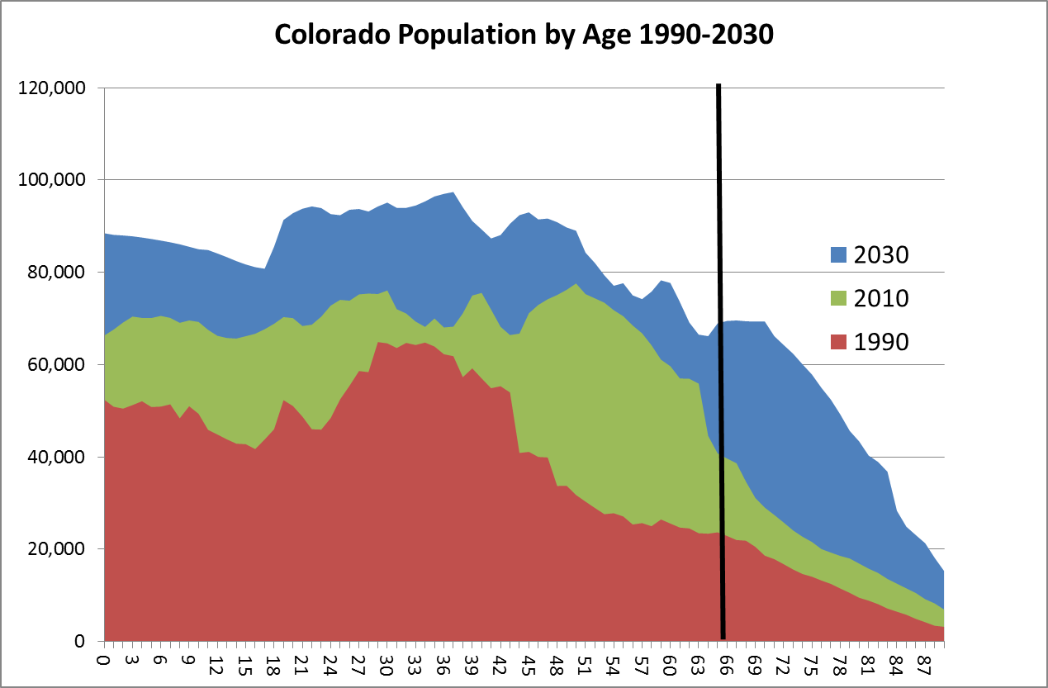
Growth in young adults due to migration

Slide 19
Demographic
Dividend

Slide 20
Aging

Slide 21
Uncertainty
J:\Projections\Evaluation\Historical projections
According to "State and Local Population Projections" by Smith, Tayman, and Swanson most state & local population projections have a MAPE of 6-7% for 10 year projections and 11-15% for 20 years.
The MAPE of Colorado's 10 year population projections produced from 1991 through 2005 is 5.2%.
The MAPE of Colorado's 20 year population projections produced in the years 1988, 1992, 1993, and 1995 is 14.3%.
(the 2005 10 year projection is evaluated against the CB 2015 estimate, all others are compared to SDO estimates 10 years later.)
Notes:
Dampening Forces: Housing Prices
Bolstering Forces: Broadband outside Front R
Survival rates
Mortality levels most certain part of the model. Relatively little variations by region or over time.
Fertility
Very accurate, however, more variation by region.
Migration
Job forecasts, relative growth by region, and labor force participation rates are all subject to error.
Consistent and within the context of national forecasts, expert review.
ange

Slide 22
Household Growth

Slide 23
Household Growth
Households grow from bleh to bleh
Household size goes from bleh to bleh
Over 65 HH go from bleh to bleh

Slide 24
Share of Households by Age 2010, 2020, 2030

Slide 25
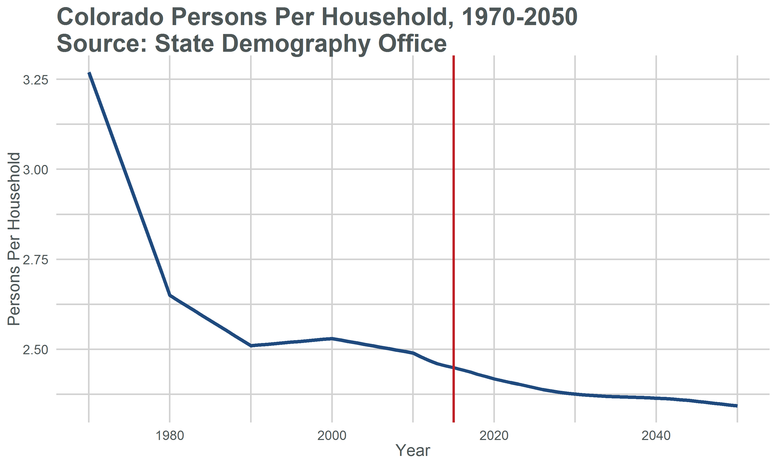

Slide 26
Household Income….its future is demographically challenged.
Age distributions – “End of “Demographic Dividend”
Occupational Mix – high and low service
More race/ethnicity diverse especially at young end but achievement gap is growing as well.
Household type and size – single and smaller.
Youth un and under employment - Long term permanent impacts on earnings.
State Demography Office

Slide 27
Thank You
State Demography Office
Department of Local Affairs
Rob Kemp
robert.kemp@state.co.us
303-864-7755
www.colorado.gov/demography

